Slide 1
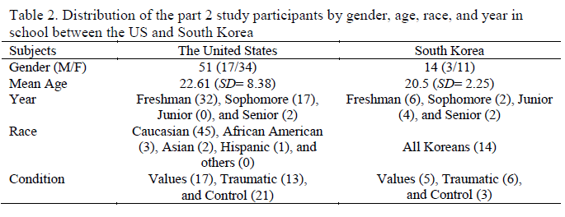
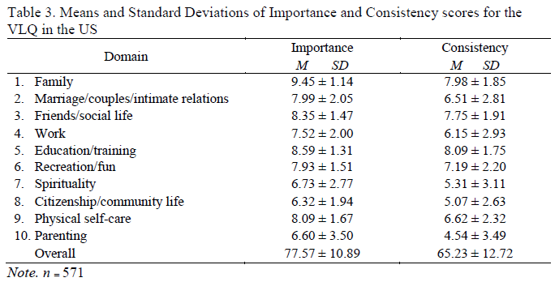
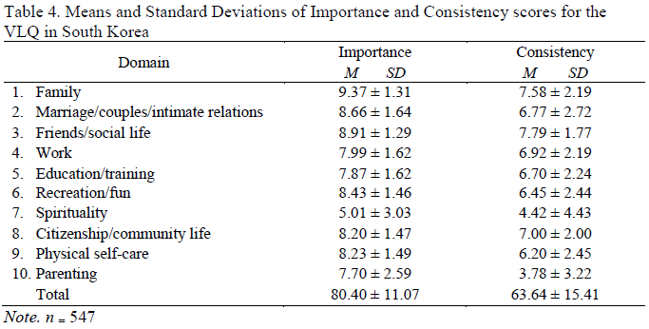
Cross-cultural Comparison on Values in ACT with Expressive Writing Paradigm
in the U.S. and South Korea
Woolee An, M.S. and Ann Rost, Ph.D.
Missouri State University
INTRODUCTION
Participants met individually with an experimenter 3 times for writing.
Prior to each writing assignment, the experiments read a written set of directions to the participant. The instruction set varied across conditions.
For Korean participants, all materials were translated into Korean, and the experimenter in S. Korea was a senior student in South Korea trained by the author.
Since there is no recruitment system in the university in South Korea, a small gift in the form of stationary was given to students who completed the writing sessions. Participants in the United States earned credit for their class.
Measure Used: both English and Korean
The Valued Living Questionnaire (VLQ)
The Profile of Mood States (POMS)
The Beck Depression Inventory (BDI)
The Beck Anxiety Inventory (BAI)
The COPE
The Acceptance and Action Questionnaire-II (AAQ-II)
Part 3: Writing Content Analysis
Actual contents of 36 writings, which were from three sessions with six people from the values group in these two countries, were compared.
Writings from South Korea were translated into English.
The author who can speak both languages, Korean and English, examined the writings for content analysis.
Each of the writings was analyzed by theme or writing topic, such as values statements and changes in their life.
Part 2: Effects of Expressive Writing
There were 17 participants in the values group, 13 participants in the traumatic group, and 21 participants in group in the control group in the US. In the South Korean sample, there were 5 participants in the values group, 6 participants in the trauma group, and 3 participants in the control group.
Friedman test was conducted to evaluate differences in median scores among control, traumatic, and value groups between the United States and South Korea.
Follow-up pairwise comparisons were conducted using a Wilcoxon test.
The values in South Korea showed significant differences in anger from the POMS (χ² (4) = 12.32, p < .05).
The control group in South Korea showed significant difference in confusion from the POMS (χ² (4) = 9.67, p < .05).
The value groups from the United States showed several significant differences, such as the VLQ total difference score (χ² (3) = 8.64, p < .05, Z= -2.54, p < .05.), the total AAQ score (χ² (4) = 15.62, p < .01, Z= -3.08, p < .01), BAI score (χ² (4) = 12.68, p < .05), Anger score from POMS (χ² (4) = 15.00, p < .01), and the total POMS score (χ² (4) = 12.40, p < .05).
The traumatic group in the United States showed significant differences in total score on the AAQ (χ² (4) = 13.46, p < .01, Z= -2.87, p < .01) and BAI (χ² (4) = 12.67, p < .05).
The control group of the United States also showed several significant differences in the VLQ total difference score (χ² (3) = 9.69, p < .05), the total score of AAQ (χ² (4) = 24.66, p < .001, Z= -3.51, p < .001), BAI score (χ² (4) = 30.18, p < .001, Z= -3.61, p < .001), the mental disengagement of COPE (χ² (4) = 9.89, p < .05, Z= -2.09, p < .05), tension score from POMS (χ² (4) = 11.57, p < .05, Z= -2.01, p < .05), anger score from POMS (χ² (4) = 10.76, p < .05, Z= -2.20, p < .05), and the total score of POMS (χ² (4) = 13.52, p < .01, Z= -2.05, p < .05).
One of the important findings from Part 2 of the study was decreased anger scores by sessions in both countries’ values groups. This might indicate that one’s feeling of anger can be decreased writing about one’s values.
Part 3: Content Comparison on Actual Writings from Participants in Study 2
The 18 writings from three sessions with six people from the values group in both countries were analyzed for the content comparison.
Different and similar values themes were confirmed from the writings between the two, consistent with the results of part 1.
While participants from the United States were focusing on relationships with significant people in their life, participants from South Korea concentrated on their relationships with people in a broader range.
The South Korean group tended to care more about what other people thought about them and how they behaved in front of other people.
Participants from the United States wrote about more varied topics such as education and recreation than the participants from South Korea.
Participants from both countries reported they are aware of the inconsistency between the degree of the importance of values and their actual behavior. However, several participants reported that they had started to do something they think of as important during the writing sessions. For example, several participants made statements such as “I am thinking about going back to church;” “Lately, I have been trying to eat healthier and work out;” “I am trying to be more consistent, especially after the self-reflection in this study;” and “I am currently committed to doing exercise.”
A more creative writing style was found from participants of the United States. While all of the participants from South Korea wrote about values that were presented on the VLQ, two of the reviewed writings from the United States included statements about what they generally think and how they shape their values
CONCLUSION
One of the distinguishing features of ACT is the emphasis on values (Hayes, 2004). The ACT model places values and value consistent behavior at the center of the therapy experience because ACT researchers believe that values provide justification, motivation and direction for the difficult work of therapy- it is the context under which all other work takes place (Wilson & Murrell, 2004).
The effects of writing about emotionally traumatic events have been topics of study for several years. This research has led to robust findings indicating that the act of writing about emotional experiences leads to significant reductions in psychological distress (Hughes, Uhlmann, & Pennebaker, 1994; Pennebaker & Beall, 1986), as well as to various other therapeutic benefits, including improved health outcomes (Pennebaker, 1990). Although ACT is an international approach, few studies have directly evaluated cultural variation, and none have examined potential differences in values and valued living across cultures. Therefore, the aim of the current study is threefold: (a) to explore similarities and differences in values between students in the United States and students in South Korea, (b) to study the impact of expressive writing on value concordant living, (c) and to examine potential differences in writing across cultures.
Value differences were detected between students from the two cultures. Although Family Relations was the most important value among students in both countries, there were different rank orders in terms of value importance and the consistency between its importance and their behavior in their life among students between the United States and South Korea. These results might indicate that value differences should be considered when value-based interventions are developed in each country.
Several statistical differences were observed between these two countries due to the impact of expressive writing. Despite the power issue, one of the important findings from Part 2 of the study was decreased anger scores by sessions in both countries’ values groups.
Results of content comparison revealed several significant within-group changes. Even though the statistical analysis did not confirm the effectiveness of expressive writing for the participants in South Korea, many participants reported that they started to act concordantly with their values.
LIMITATION AND FUTURE DIRECTION
METHOD
Due to the small sample of participants from South Korea, the data from the expressive writing condition was insufficient to draw any conclusions about the effectiveness of expressive writing toward fostering a value concordant life. In order to have better statistical power, more data should be collected from a larger sample.
Better content analysis is needed. Using quantitative analysis followed by a content analysis would allow for better understanding of these cultural differences.
Due to small sample size in this group, it was not possible to analyze the data based on the degree of the concordance. Group differences were obvious between a highly concordant group and low concordant group. It may be useful to examine the different impact of expressive writing in both groups.
Despite these limitations, there has not been a study of values in ACT with a cross-cultural perspective, these attempts should prove fruitful for future investigation.
When considering the value differences between individualism and collectivism, which were supported by the results from the part 1, cultural adaptation should be considered when values are explored as a core for treatment intervention in the future.
A longer term perspective for values based interventions might be needed. One of the participants wrote about value conflicts during the writing session in this study. Emmons (2003) pointed out the ambivalence between goal striving and goal pursuit as tending to inhibit one’s subjective well-being. Research results suggest it is not easy to achieve psychological improvement when participants try to engage in only value exploration. Therefore, value clarification is not enough, and the actual practice of values should also be included (Park & Lee, 2012), possibly through long term value-based programs.
Part 1: Comparison of Valued Living Questionnaire
Participants included a group of college students in the United States (N=571, 63% Female, 81% Caucasian ), and a comparison group of college students in South Korea (N=547, 61% Female, 100% Korean).
The Institutional Review Board (IRB) at Missouri State University reviewed and approved the study (October 1, 2013)
Procedure: Students in South Korea were invited to participate in the pre-screening session via Psychology related courses. Students in the U.S. included in the archival data set were first invited to participate in this study via the SONA system.
Measures Used:
Demographics
The Valued Living Questionnaire (VLQ)
Part 2: Effects of Expressive Writing
A total of 14 students from the South Korean sample participated in the expressive writing study. More female students (11) as compared to male students (3) were in this sample.
Archival data from the MSU sample included 51 students, 17 males (33.3%), and 34 females (66.7%), with an average age of 22.6 years.
Procedure: Based upon VLQ scores, obtained during Part 1 of the study, those who were deemed to be highly concordant (values scores of 12 or below), and those who were highly disconcordant (values score of 28 and above), were invited to participate in the writing task.
Participated were randomly assigned to one of three writing instruction sets, which included (1) typical Pennebaker instructions of writing about a personal traumatic event, (2) a values instruction set, in which participants were told to write about their values and their personal behavior in relation to these values, and (3) a control condition, in which participants wrote about their shoes, closet, and living room.
These writing tasks occurred over the course of 3 weeks. At the first meeting, the participants completed measures prior to writing about the instructed topic for 20 minutes. The second and third time, they completed the VLQ, wrote for 20-minutes, and then completed the study measures again.
RESULTS
Part 1: Comparison of Valued Living Questionnaire
The average score of value importance from students in South Korea was higher than the participants from the United States. However, the average score of total consistency from the students in South Korea was lower than the score of students from the United States. This larger discrepancy between value importance and consistency among students in South Korea might mean that students experience higher distress than students in the United States.
REFERENCES
Emmons, R. A. (2003). Personal goals, life meaning, and virtue: Wellsprings of a positive life.
Flourishing: Positive psychology and the life well-lived, 105-128.
Hayes, S. C. (2004). Acceptance and Commitment Therapy, Relational Frame Theory, and the third wave of behavioral and cognitive therapies. Behavior Therapy, 35, 639-665.
Hughes, C. F., Uhlmann, C., Pennebaker, J. W. (1994). The body’s response to processing emotional trauma: Linking verbal text with autonomic activity. Journal of Personality, 62, 565-585.
Park, S. & Lee, H. (2012). The Effect of the ACT-Based Value Exploration Program on Valued Living and Psychological Adjustment. Cognitive Behavior Therapy in Korea, 12(1), 1-20
Pennebaker, J.W. (1990). Opening up: The healing power of expressing emotions. New York: Guilford Press.
Pennebaker, J. W., Beall, S. (1986). Confronting a traumatic event: Toward an understanding of inhibition and disease. Journal of Abnormal Psychology, 95, 274-281.
Wilson, K. G., & Murrell, A. R. (2004). Values work in acceptance and commitment therapy. Mindfulness and acceptance: Expanding the cognitive–behavioral tradition. New York: Guilford, 120-151.

